Slide 1
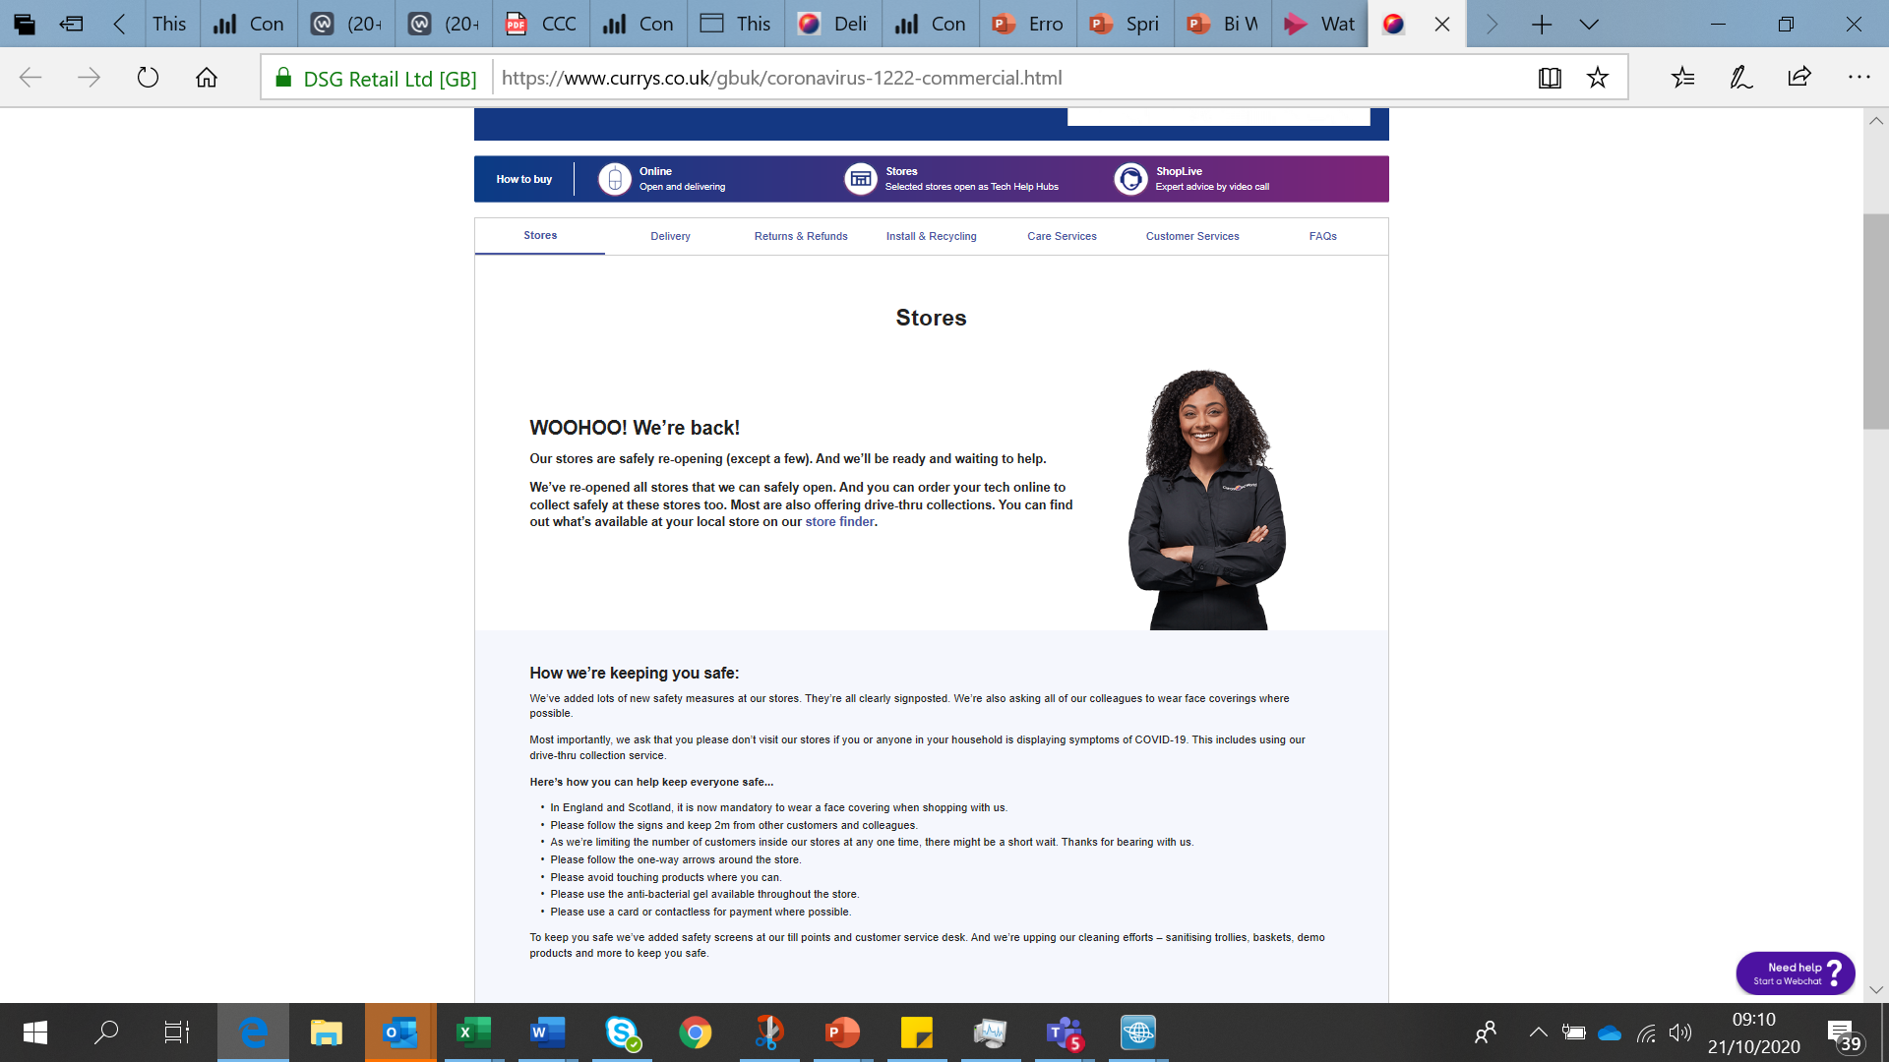
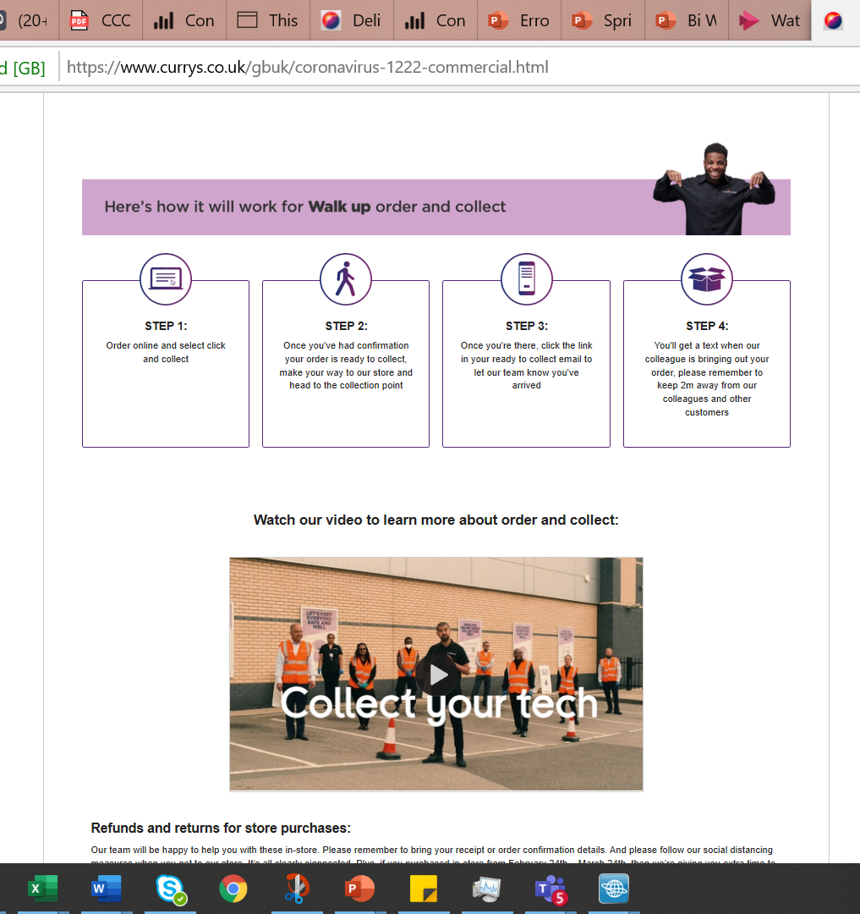
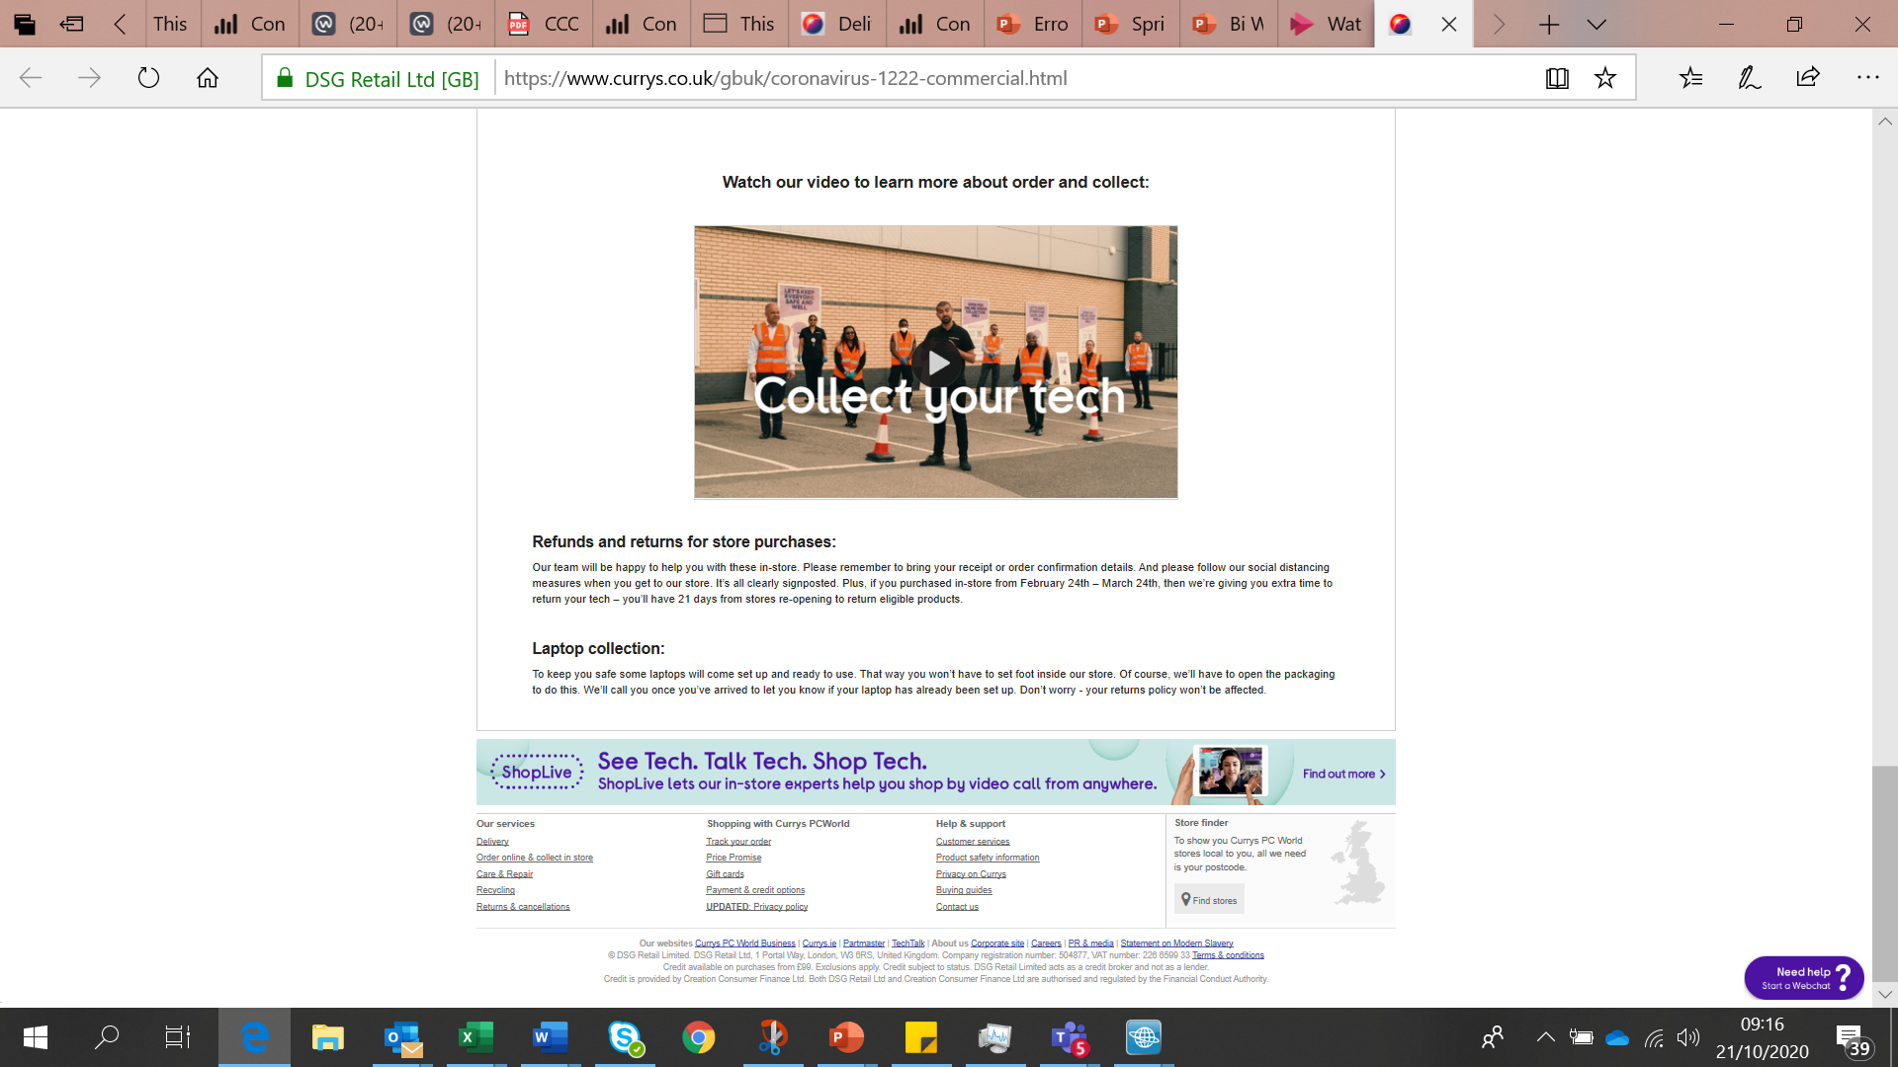
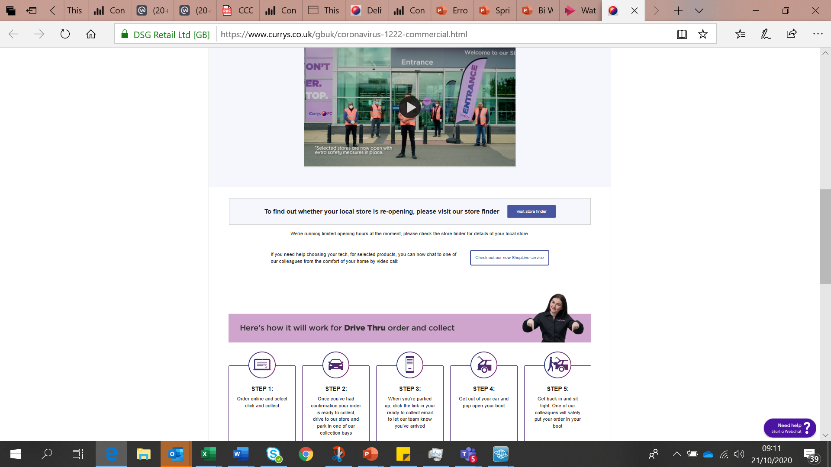
Longer term – we need to get all of this good collection content onto the main collection pages
Stores
We’re open…where we can be! (banner)
We are open as normal across England, Scotland and Northern Ireland. Due to the current Covid welsh restrictions in Wales stores will be completely closed from 6pm on the on 23/10 until the 9th November.
To find out if your nearest store is open click here (store locator)
Please visit our general FAQs for help with any queries you may have.
If you can’t come to our stores at the moment, our in-store experts are available online by video call to give you buying advice about any laptop, TV or household appliance. Just look out for the ShopLive icon throughout our website.
Any return periods will exclude the dates that stores are closed.
Delete

Slide 2
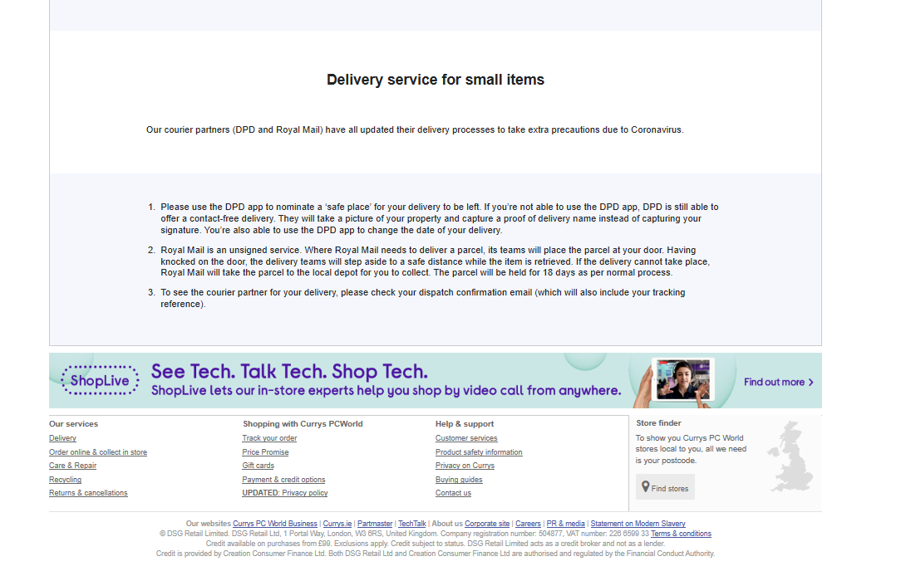
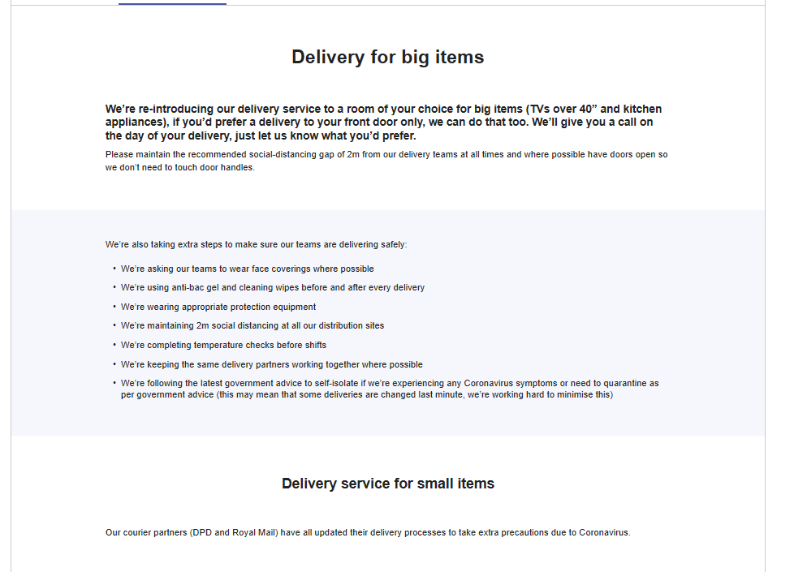
Delivery all BAU no amendments to make

Slide 3
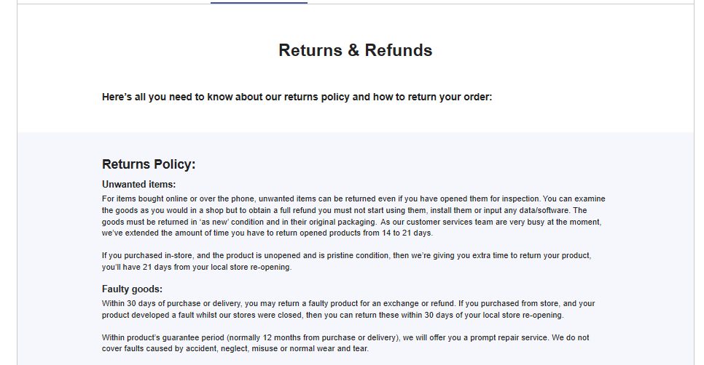
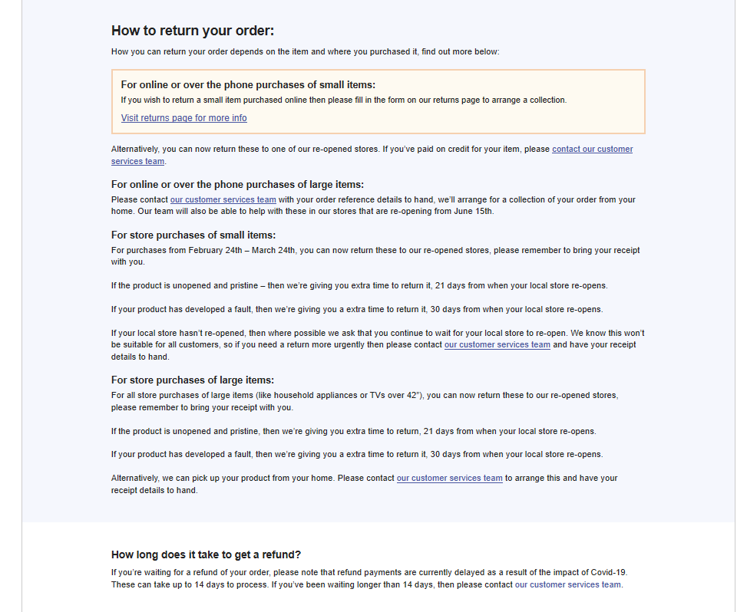
Returns – add note below
Store returns
Whilst stores are closed, you can hold onto you purchase until stores open, we will extend the returns period so that it doesn’t include the time the store was closed.

Slide 4
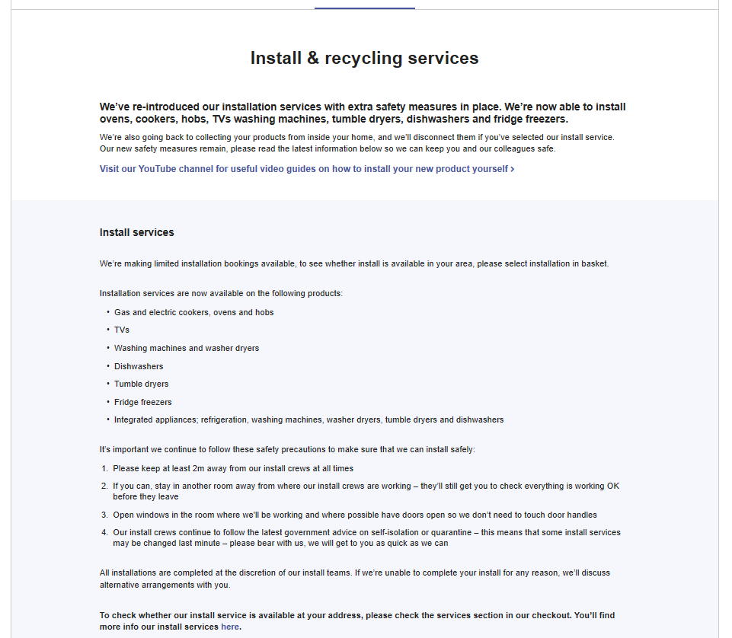
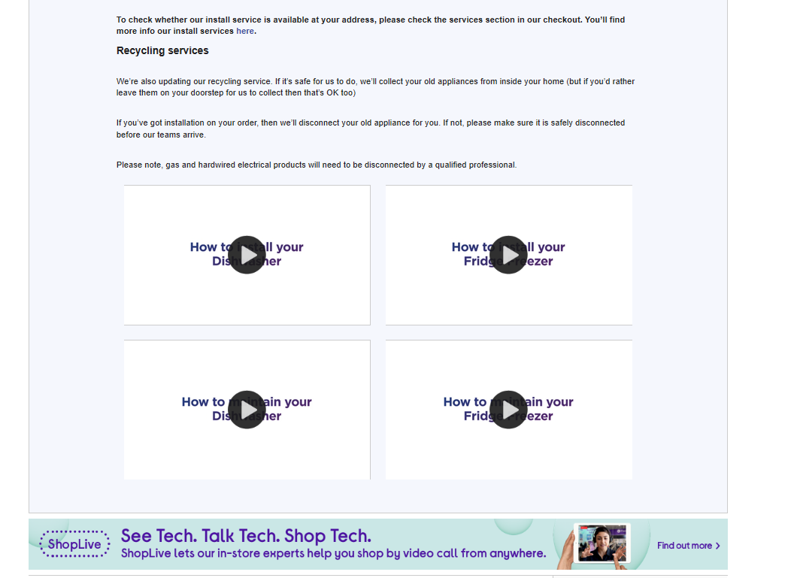
Install & recycling – all BAU nothing to add

Slide 5
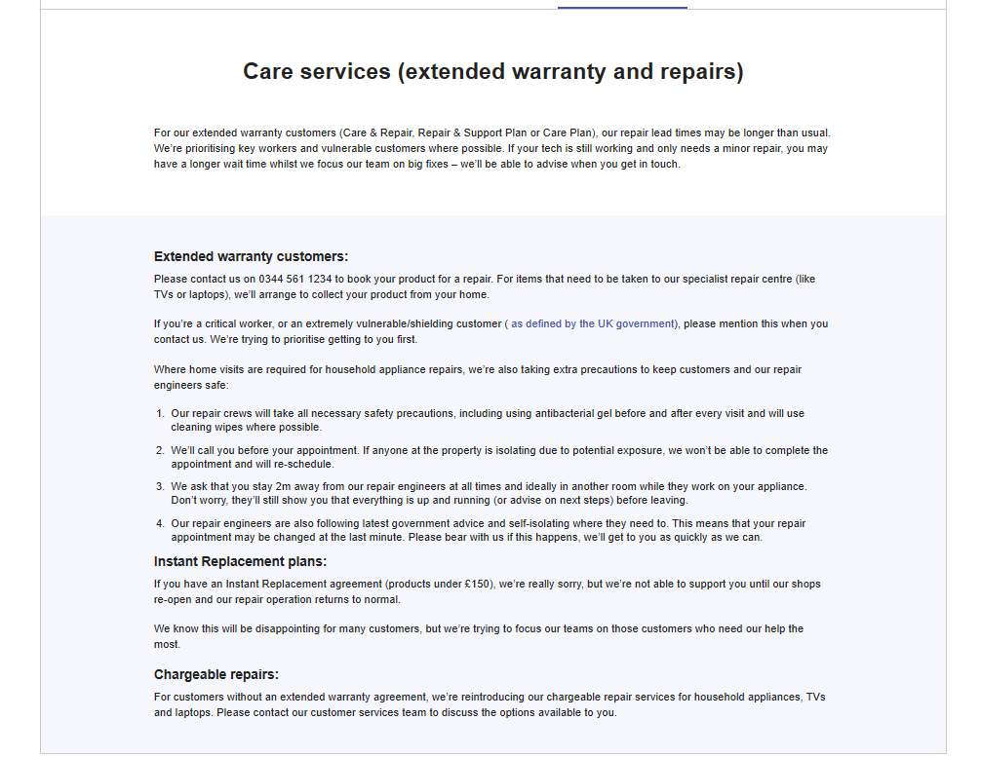
Care services

Slide 6
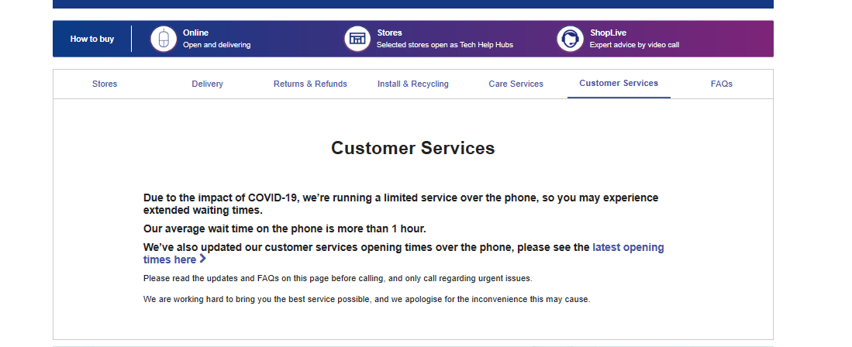
Customer Services – No amendments needed

Slide 7
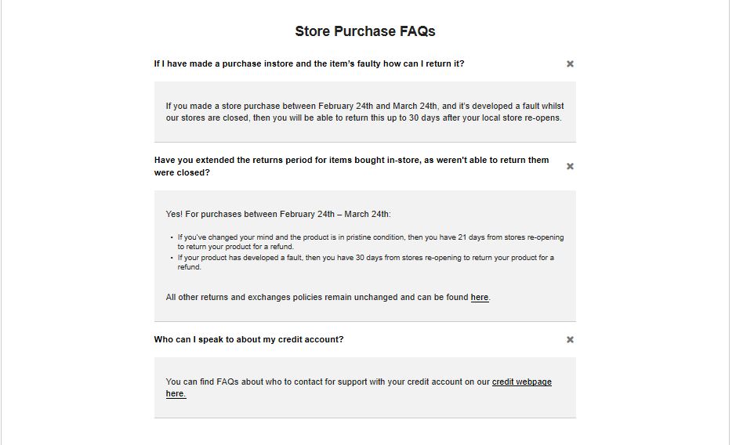
Store purchase FAQs – To follow on (in word doc)

Slide 8
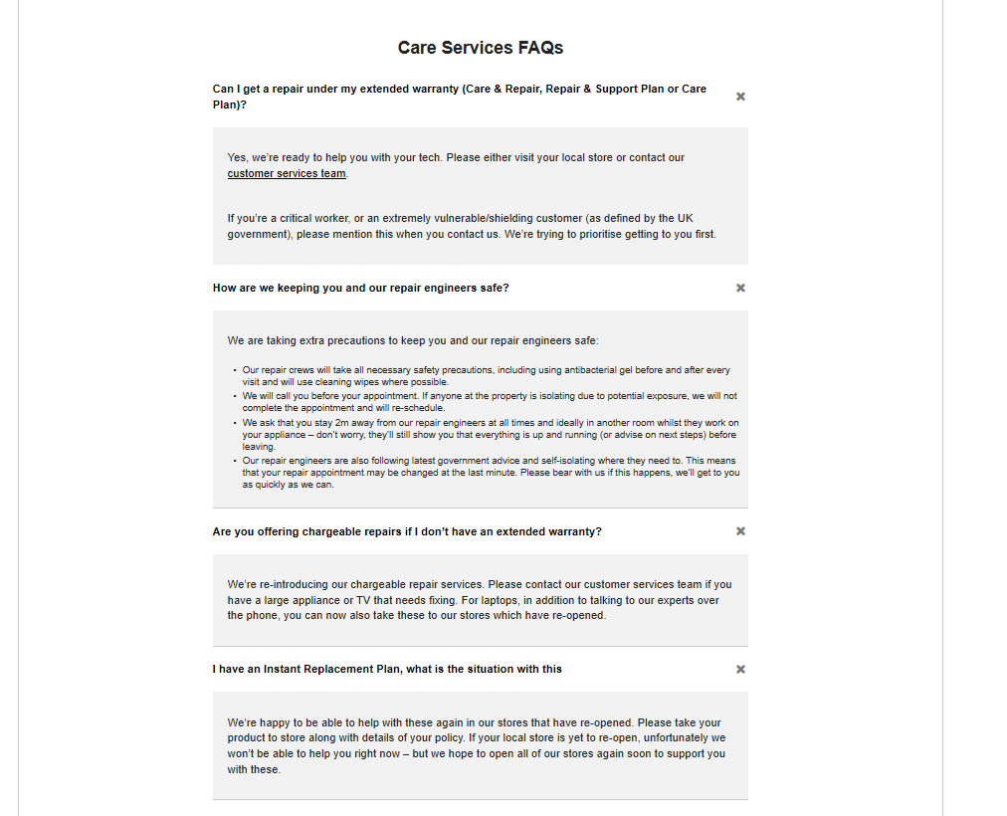
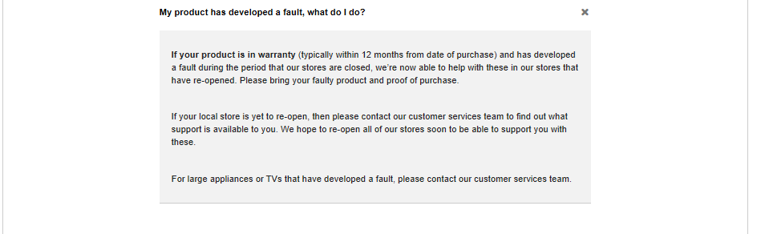
Care services –

Slide 9
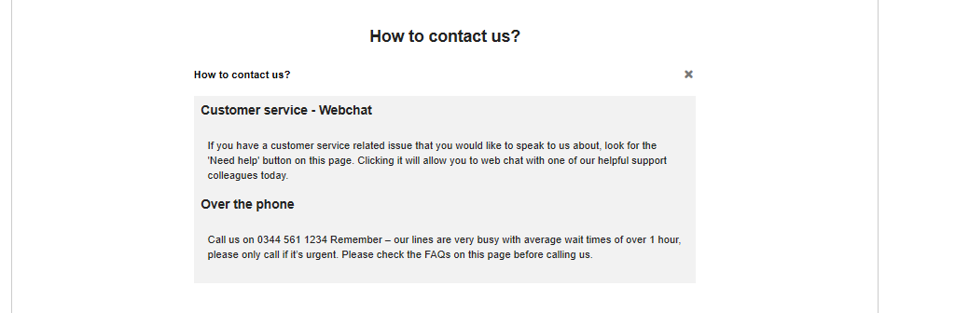
Contact us – no amendment needed.

Slide 10
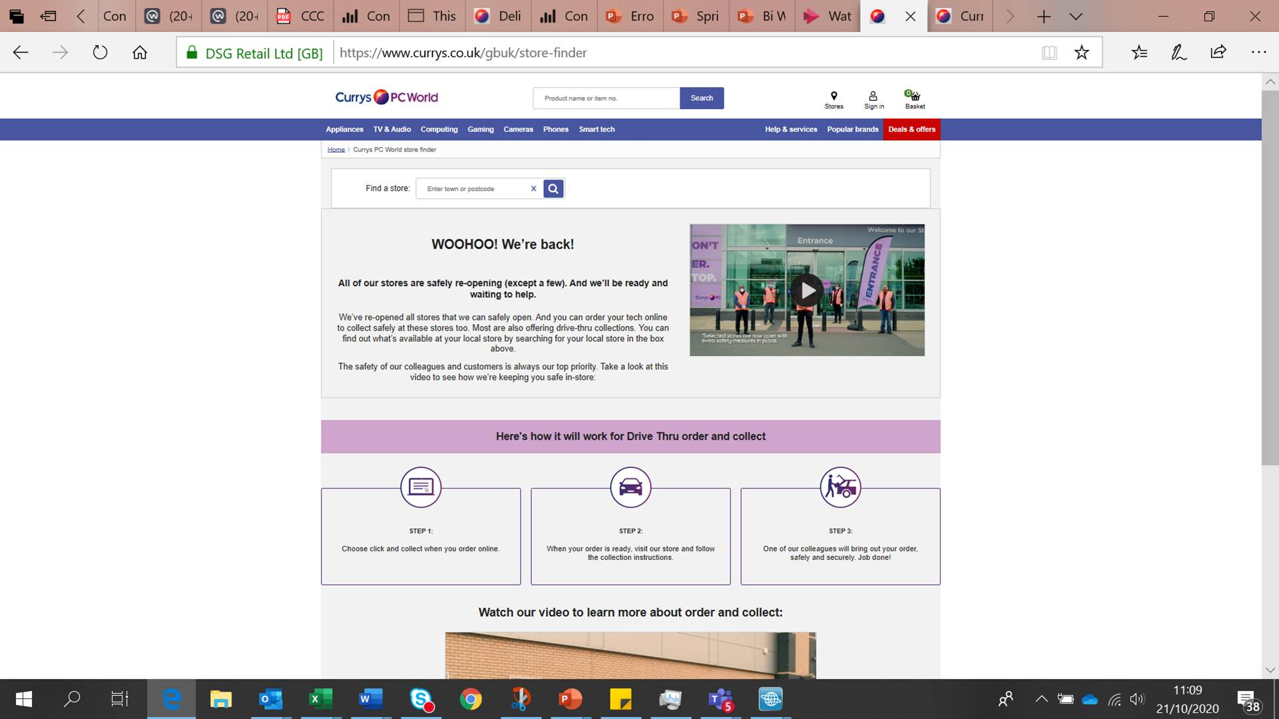
Remove woohoo we’re back to We’re open…where we can be!
We are open as normal across England, Scotland and Northern Ireland. Due to the current Covid welsh restrictions in Wales stores will be completely closed from 6pm on the on 23/10 until the 9th November.
To find out if your nearest store is open click here (store locator)

